Slide 1
NT101-Network Security
Week 02 Cryptographic algorithms
Ngoc-Tu Nguyen, PhD
tunn@uit.edu.vn

Slide 2
Outline
Motivations
Cipher algorithms
Symmetric ciphers: AES;
Asymmetric ciphers: RSA, ELGAMAL, and ECC
Session key agreement
Diffie–Hellman (DH) Algorithm
Verifying data integrity and authenticity
Hash funtion
HMAC
Digital signature
Digital certificate

Slide 3
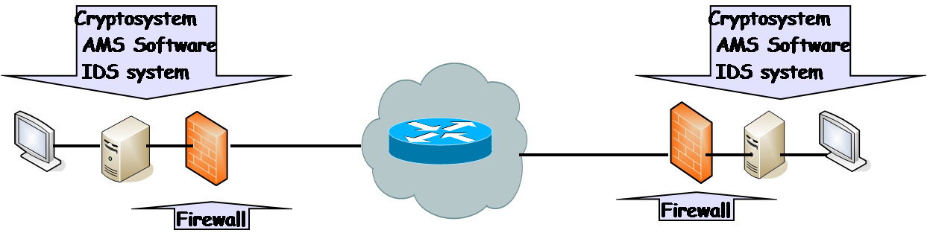
Basic Security Model (review)
The basic security model consists of four components: cryptosystems, firewalls, anti-malicious-software systems (AMS software), and intrusion detection system (IDS)
Notes:
IDS= Intrusion detection system (phat hien sam nhap)

Slide 4
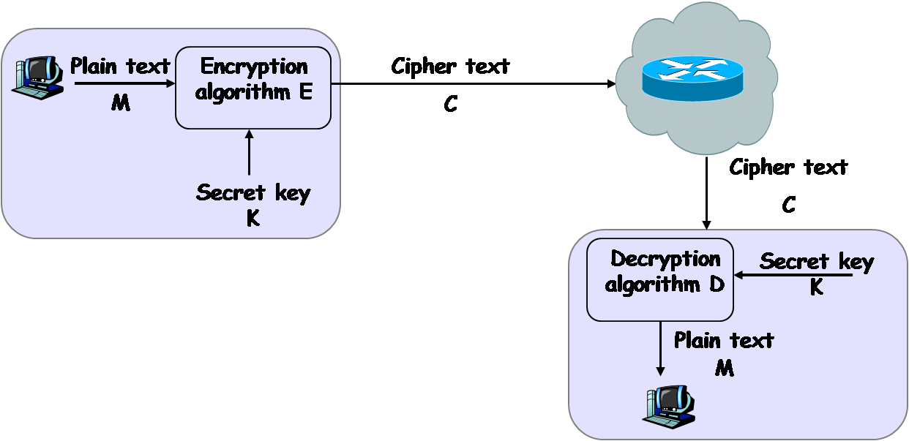
Network model of cryptosystem cipher (review)

Slide 5
Motivations
Security goals?
Confidentiality
including data in transmission and storage states
Privacy
Data integrity
including data in transmission and storage state
Authentication
All nodes in network, users, API,..
Non-repudiation
Availability
cipher algorithms
key agreement
HMAC,
Digital signature
Digital certificate

Slide 6
Advanced Encryption Standard
Advanced Encryption Standard competition began in 1997
Rijndael was selected to be the new AES in 2001
AES basic structures:
block cipher, but not Feistel cipher
encryption and decryption are similar, but not symmetrical
basic unit: byte, not bit
block size: 16-bytes (128 bits)
three different key lengths: 128, 192, 256 bits
AES-128, AES-192, AES-256
each 16-byte block is represented as a 4 x 4 square matrix, called the state matrix
the number of rounds depends on key lengths
4 simple operations on the state matrix every round (except the last round)

Slide 7
The Four Simple Operations
substitute-bytes (sub)
Non-linear operation based on a defined substitution box
Used to resist cryptanalysis and other mathematical attacks
shift-rows (shr)
Linear operation for producing diffusion
mix-columns (mic)
Elementary operation also for producing diffusion
add-round-key (ark)
Simple set of ⊕ operations on state matrices
Linear operation
Produces confusion

Slide 8
AES state matrix
16 bytes
The matrix A
a_{0,0} a_{0,1} a_{0,2} a_{0,3}
A)= a_{1,0} a_{1,1} a_{1,2} a_{1,3}
a_{2,0} a_{2,1} a_{2,2} a_{2,3}
a_{3,0} a_{3,1} a_{3,2} a_{3,3}

Slide 9
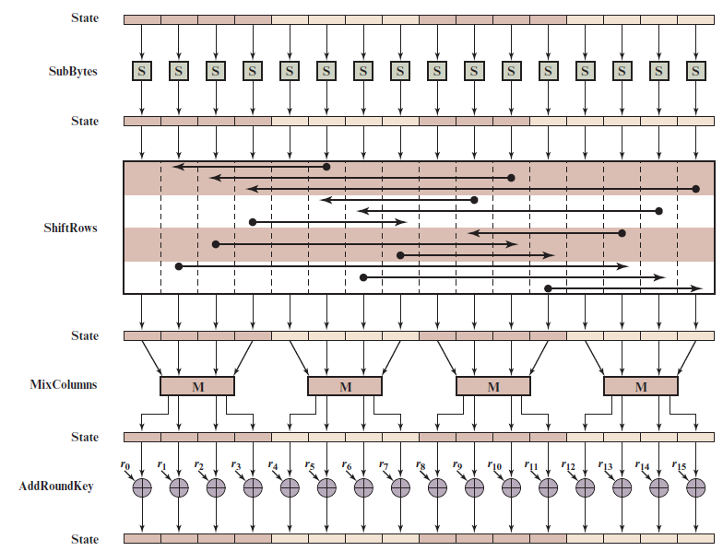
A E S Encryption Round
Notes:
Figure 6.4 depicts the structure of a full encryption round.

Slide 10
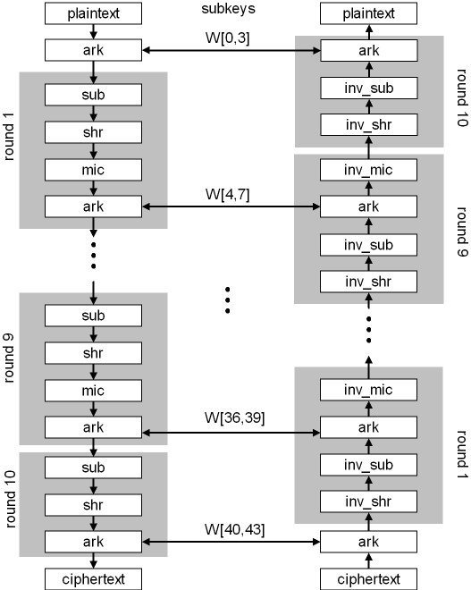
AES-128

Slide 11
AES S-Box
S-box: a $16×16$ matrix built from operations over finite field GF(2⁸)
permute all 256 elements in GF(2⁸)
each element and its index are represented by two hexadecimal digits
Let w = b₀ ... b₇ be a byte. Define a byte-substitution function S as follows:
Let i = b₀b₁b₂b₃, the binary representation of the row index
Let j = b₄b₅b₆b₇, the binary representation of the column index
Let S(w) = s_{ij,} S⁻¹(w) = s’_{ij}
We have S(S⁻¹(w)) = w and S⁻¹(S(w)) = w

Slide 12
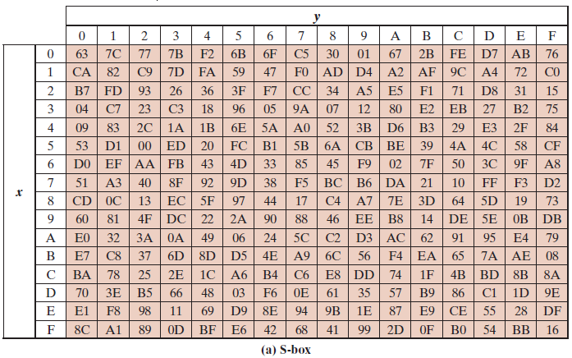
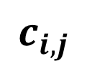
AES S-Boxes (1 of 2)
column
w = b₀b₁ b₂ b₃ b₄ b₅ b₆ b₇
$$c_{i,j}$$
row
j = b₄b₅b₆b₇,
i = b₀b₁b₂b₃

Slide 13
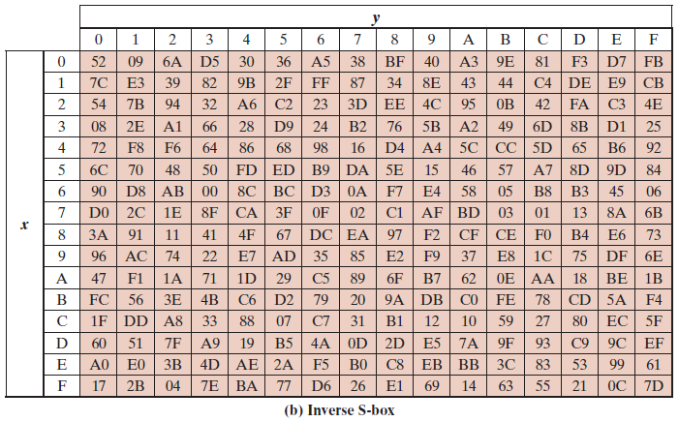
AES S-Boxes (2 of 2)
Notes:
The inverse substitute byte transformation , called InvSubBytes, makes use
of the inverse S-box shown in Table 6.2b.

Slide 14
Substitute-Bytes (sub)
Substitution function that takes a byte as an input, uses its first four bits as the row index and the last four bits as the column index, and outputs a byte using a table-lookup at the S-box
Let A be a state matrix. Then
S(a_{0,0} ) S(a_{0,1} ) S(a_{0,2} ) S(a_{0,3} )
sub(A) = S(a_{1,0} ) S(a_{1,1} ) S(a_{1,2} ) S(a_{1,3} )
S(a_{2,0} ) S(a_{2,1} ) S(a_{2,2} ) S(a_{2,3} )
S(a_{3,0} ) S(a_{3,1} ) S(a_{3,2} ) S(a_{3,3} )
sub⁻¹(A) will just be the inverse substitution operation applied to the matrix
S⁻¹ (a_{0,0} ) S⁻¹ (a_{0,1} ) S⁻¹ (a_{0,2} ) S⁻¹ (a_{0,3} )
sub⁻¹ (A) = S⁻¹ (a_{1,0} ) S⁻¹ (a_{1,1} ) S⁻¹ (a_{1,2} ) S⁻¹ (a_{1,3} )
S⁻¹ (a_{2,0} ) S⁻¹ (a_{2,1} ) S⁻¹ (a_{2,2} ) S⁻¹ (a_{2,3} )
S⁻¹ (a_{3,0} ) S⁻¹ (a_{3,1} ) S⁻¹ (a_{3,2} ) S⁻¹ (a_{3,3} )
We have sub(sub⁻¹(A)) = sub⁻¹(sub(A)) = A

Slide 15
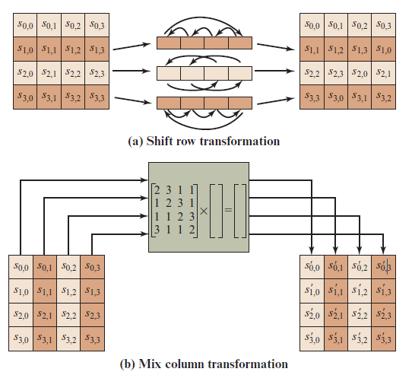
A E S Row and Column Operations
Notes:
The forward shift row transformation ,
called ShiftRows, is depicted in Figure 6.7a. The first row of State is not altered. For
the second row, a 1-byte circular left shift is performed. For the third row, a 2-byte
circular left shift is performed. For the fourth row, a 3-byte circular left shift is performed.
The following is an example of ShiftRows.
The inverse shift row transformation , called InvShiftRows, performs the circular
shifts in the opposite direction for each of the last three rows, with a 1-byte
circular right shift for the second row, and so on.
The forward mix column transformation,
called MixColumns, operates on each column individually. Each byte of a column
is mapped into a new value that is a function of all four bytes in that column. The
transformation can be defined by the following matrix multiplication on State
(Figure 6.7b)
Each element in the product matrix is the sum of products of elements of one row
and one column. In this case, the individual additions and multiplications are
performed in GF(2⁸ ).

Slide 16
Shift-Rows (shr)
shr(A) performs a left-circular-shift i – 1 times on the i-th row in the matrix A
a_{0,0} a_{0,1} a_{0,2} a_{0,3}
shr(A) = a_{1,1} a_{1,2} a_{1,3} a_{1,0}
a_{2,2} a_{2,3} a_{2,0} a_{2,1}
a_{3,3} a_{3,0} a_{3,1} a_{3,2}
shr⁻¹(A) performs a right-circular-shift i – 1 times on the i-th row in the matrix A
a_{0,0} a_{0,1} a_{0,2} a_{0,3}
shr⁻¹(A)= a_{1,3} a_{1,0} a_{1,1} a_{1,2}
a_{2,2} a_{2,3} a_{2,0} a_{2,1}
a_{3,1} a_{3,2} a_{3,3} a_{3,0}
We have shr(shr⁻¹(A)) = shr⁻¹(shr(A)) = A

Slide 17
Mix-Columns (mic)
mic(A) = [a’_{ij}]_{4×4} is determined by the following operation (j = 0, 1, 2, 3):
a’_{0,j} = M (a_{0,j}) ⊕ [M (a_{1,j}) ⊕ a_{1,j}] ⊕ a_{2,j} ⊕ a_{3,j}
a’_{1,j} = a_{0,j} ⊕ M (a_{1,j}) ⊕ [M (a_{2,j} )⊕a_{2,j}] ⊕ a_{3,j}
a’_{2,j} = a_{0,j} ⊕ a_{1,j} ⊕ M (a_{2,j} ) ⊕ [M (a_{3,j} ) ⊕ a_{3,j}]
a’_{3,j} = [M (a_{0,j} )⊕ a_{0,j} ] ⊕ a_{1,j} ⊕ a_{2,j} ⊕ M (a_{3,j} )
mic⁻¹(A) is defined as follows:
Let w be a byte and i a positive integer:
M ^{i}(w) = M (M ^{i-1}(w)) (i > 1), M ¹(w) = M (w)
Let
M₁(w) = M³(w) ⊕ M²(w) ⊕ M(w)
M₂(w) = M³(w) ⊕ M(w) ⊕ w
M₃(w) = M³(w) ⊕ M²(w) ⊕ w
M₄(w) = M³(w) ⊕ w
mic⁻¹(A) = [a’’_{ij}]_{4×4} :
a’’_{0,j} = M₁(a_{0,j}) ⊕ M₂(a_{1,j}) ⊕ M₃(a_{2,j}) ⊕ M₄(a_{3,j})
a’’_{1,j} = M₄(a_{0,j}) ⊕ M₁(a_{1,j}) ⊕ M₂(a_{2,j}) ⊕ M₃(a_{3,j})
a’’_{2,j} = M₃(a_{0,j}) ⊕ M₄(a_{1,j}) ⊕ M₁(a_{2,j}) ⊕ M₂(a_{3,j})
a’’_{3,j} = M₂(a_{0,j}) ⊕ M₃(a_{1,j}) ⊕ M₄(a_{2,j}) ⊕ M₁(a_{3,j})
We have mic(mic⁻¹(A)) = mic⁻¹(mic(A)) = A

Slide 18
Add Round Keys (ark)
Rewrite K_{i} as a 4 x 4 matrix of bytes:
k_{0,0} k_{0,1} k_{0,2} k_{0,3}
K_{i} = k_{1,0} k_{1,1} k_{1,2} k_{1,3}
k_{2,0} k_{2,1} k_{2,2} k_{2,3}
k_{3,0} k_{3,1} k_{3,2} k_{3,3}
where each element is a byte and W[4i + j] = k_{0,j}k_{1,j}k_{2,j}k_{3,j}, j = 0, 1 , 2, 3
Initially, let a = M
k_{0,0}⊕ a_{0,0} k_{0,1}⊕ a_{0,1} k_{0,3} ⊕ a_{0,3} k_{0,4} ⊕ a_{0,4}
ark(a, K_{i}) = a ⊕ K_{i} = k_{1,0}⊕ a_{1,0} k_{1,1}⊕ a_{1,1} k_{1,2} ⊕ a_{1,2} k_{1,3} ⊕ a_{1,3} k_{2,0}⊕ a_{2,0} k_{2,1}⊕ a_{2,1} k_{2,2} ⊕ a_{2,2} k_{2,3} ⊕ a_{2,3} k_{3,0}⊕ a_{3,0} k_{3,1}⊕ a_{3,1} k_{3,2} ⊕ a_{3,2} k_{3,3} ⊕ a_{3,3}
Since this is a ⊕ operation, ark^{–1} is the same as ark. We have
ark(ark^{–1}(a, K_{i}), K_{i}) = ark^{–1}(ark(a, K_{i}), K_{i}) = a

Slide 19

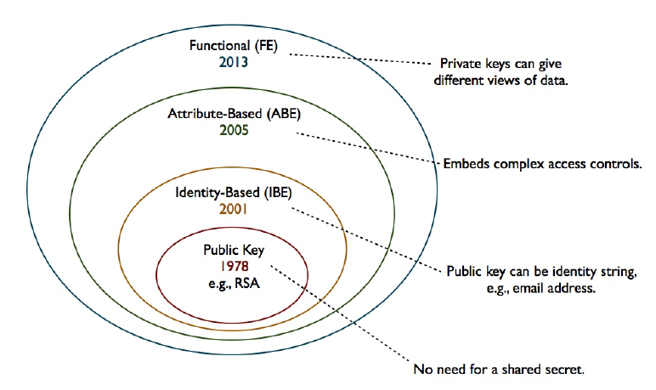
Motivations
Symmetric cipher vs Asymmetric cipher

Slide 20
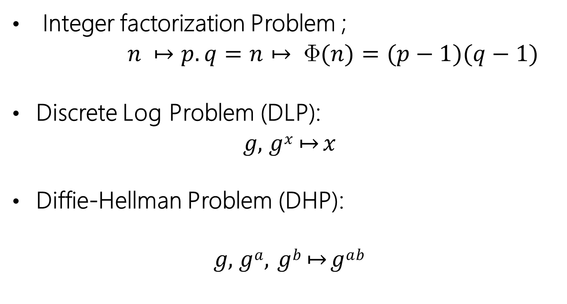
Computational hardness assumptions
Integer factorization Problem ;
$n ↦p.q=n↦ (n)=(p−1)(q−1)$
Discrete Log Problem (DLP):
𝑔, 𝑔^{𝑥} ↦ 𝑥
Diffie-Hellman Problem (DHP):
𝑔, 𝑔^{𝑎}, 𝑔^{𝑏} ↦ 𝑔^{𝑎𝑏}

Slide 21
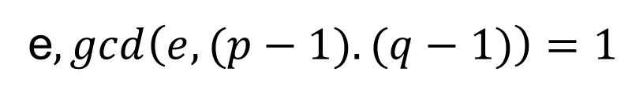
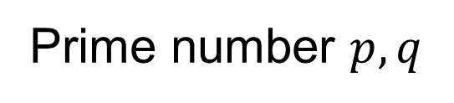
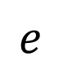
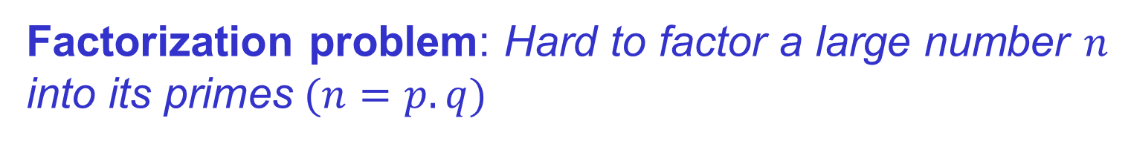
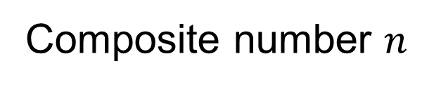
Factorization problem
Hardness assumption (One-way function)
Factorization problem: Hard to factor a large number $n$
into $\text{its} \text{primes} (n=p.q)$
Easy to
compute
Prime number $p,q$
e$,gcd\left(e,(p−1).(q−1)\right)=1$
“Hard”
to compute
Composite number $n$
$$e$$

Slide 22
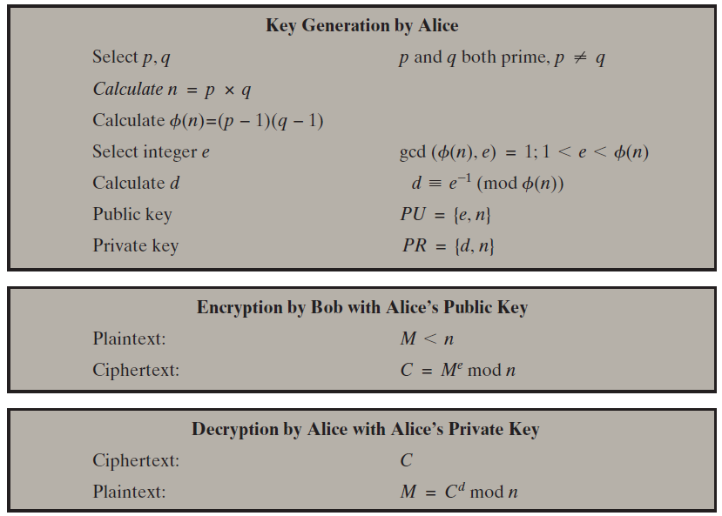
The R S A Algorithm
Notes:
Figure 9.5 summarizes the RSA algorithm. It corresponds to Figure 9.1a: Alice
generates a public/private key pair; Bob encrypts using Alice’s public key; and Alice
decrypts using her private key.

Slide 23
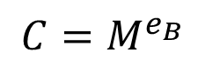
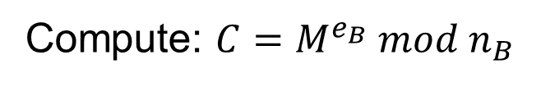
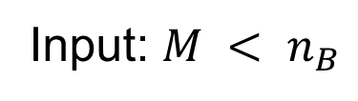
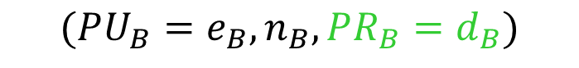
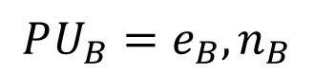
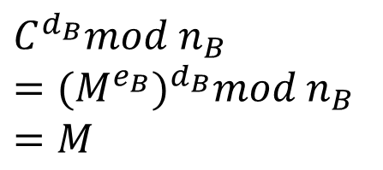
The R S A
Alice
public key
Bob
public key
?
public key
private key
$$PU_{B}=e_{B},n_{B}$$
$$(PU_{B}=e_{B},n_{B},PR_{B}=d_{B})$$
Input: $M < n_{B}$
$$C=M^{e_{B}}$$
Compute: $C=M^{e_{B}} mod n_{B}$
Compute:
$$C^{d_{B}}mod n_{B}$$
$$={{(M}^{e_{B}})}^{d_{B}}mod n_{B}$$
$$=M$$

Slide 24
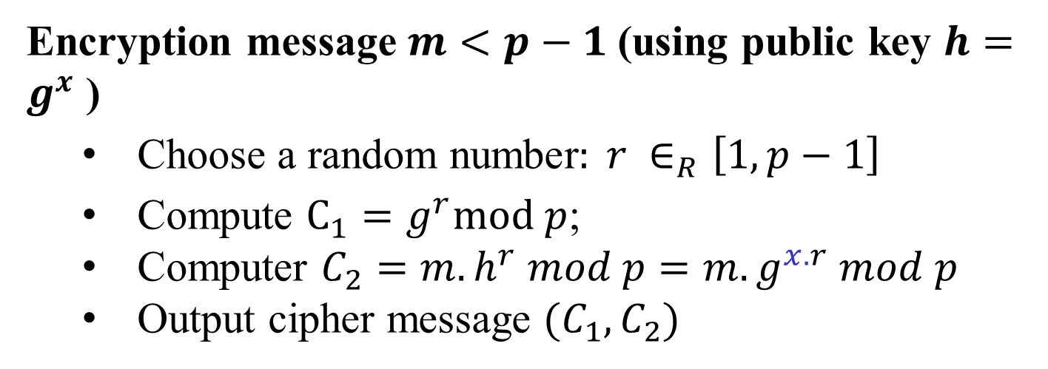
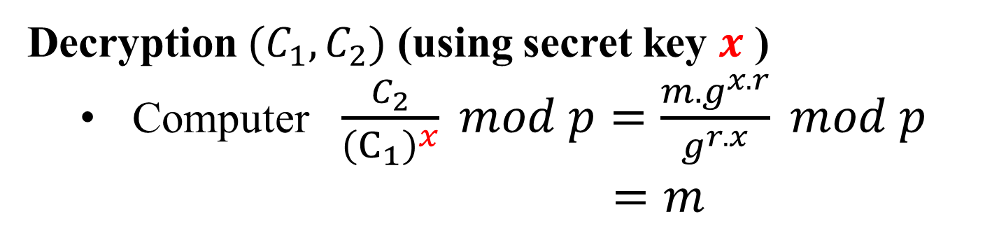
ElGamal cipher
Encryption message $m<p−1$(using public key $h=g^{x}$ )
Choose a random number$: r ∈_{R}\left[1,p−1\right]$
Compute $C_{1}=g^{r}mod p$;
Computer $C_{2}=m.h^{r} mod p=m.g^{x.r} mod p$
Output cipher message $(C_{1},C_{2})$
Decryption $(C_{1},C_{2})$ (using secret key $x$ )
Computer $\frac{C_{2}}{{\left(C_{1}\right)}^{x}} mod p=\frac{m.g^{x.r}}{g^{r.x}} mod p$
$=m$

Slide 25
Diffie-Hellman key exchange
Alice and Bob never met and share no secrets
Public info: p and g
p is a large prime number, g is a generator of Z_{p}*
Z_{p}*={1, 2 … p-1}; ∀a∈Z_{p}* ∃i such that a=g^{i} mod p
Pick secret, random x
Pick secret, random y
g^{x} mod p
g^{y} mod p
Alice
Bob
Compute k=(g^{y})^{x}=g^{xy} mod p
Compute k=(g^{x})^{y}=g^{xy} mod p

Slide 26
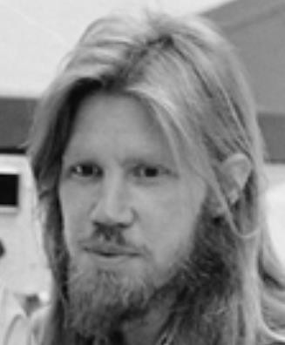
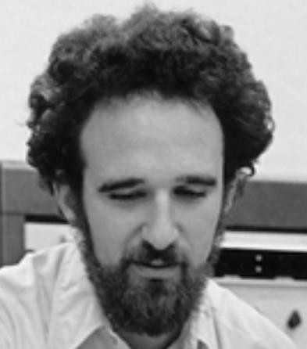
Diffie-Hellman key exchange
p= 1606938044258990275541962092341162602522202993782792835301301
𝑔 = 123456789
𝑔^{𝑎} mod 𝑞 = 78467374529422653579754596319852702575499692980085777948593
560048104293218128667441021342483133802626271394299410128798 = 𝑔^{𝑏} mod 𝑞
𝑎 =
685408003627063
761059275919665
781694368639459
527871881531452
𝑏 =
362059131912941
987637880257325
269696682836735
524942246807440
𝑔^{𝑎𝑏} mod p = 437452857085801785219961443000845969831329749878767465041215

Slide 27
Hash function and MACs
Hash function
Message Authentication Codes (MAC)
Digital signature
Digital certificate
can provide
Integrity ☑
Authentication ☑
Availability ☑
Non-repudiation ☑
Further reading (Wikipedia)
Cryptographic Hash Functions
Message Authentication Code

Slide 28
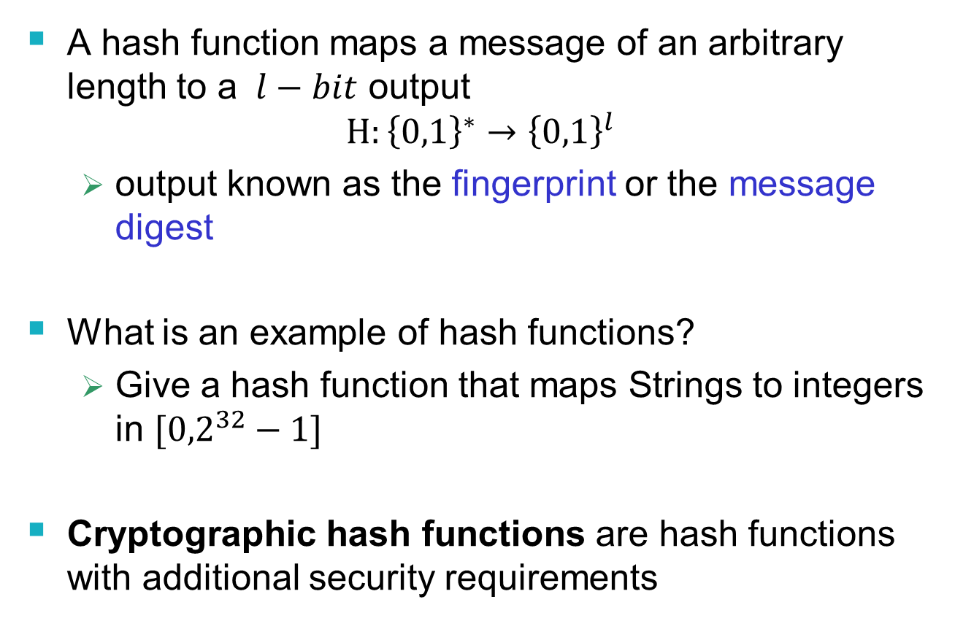
Hash Functions
A hash function maps a message of an arbitrary length to a $l−bit$ output
$$H:{\left\{0,1\right\}}^{∗}→{\left\{0,1\right\}}^{l}$$
output known as the fingerprint or the message digest
What is an example of hash functions?
Give a hash function that maps Strings to integers in $[{0,2}^{32}−1]$
Cryptographic hash functions are hash functions with additional security requirements
Notes:
Example hash function: v:=1; for each character c, v=v*(c+1)+2 mod 2^{32};

Slide 29
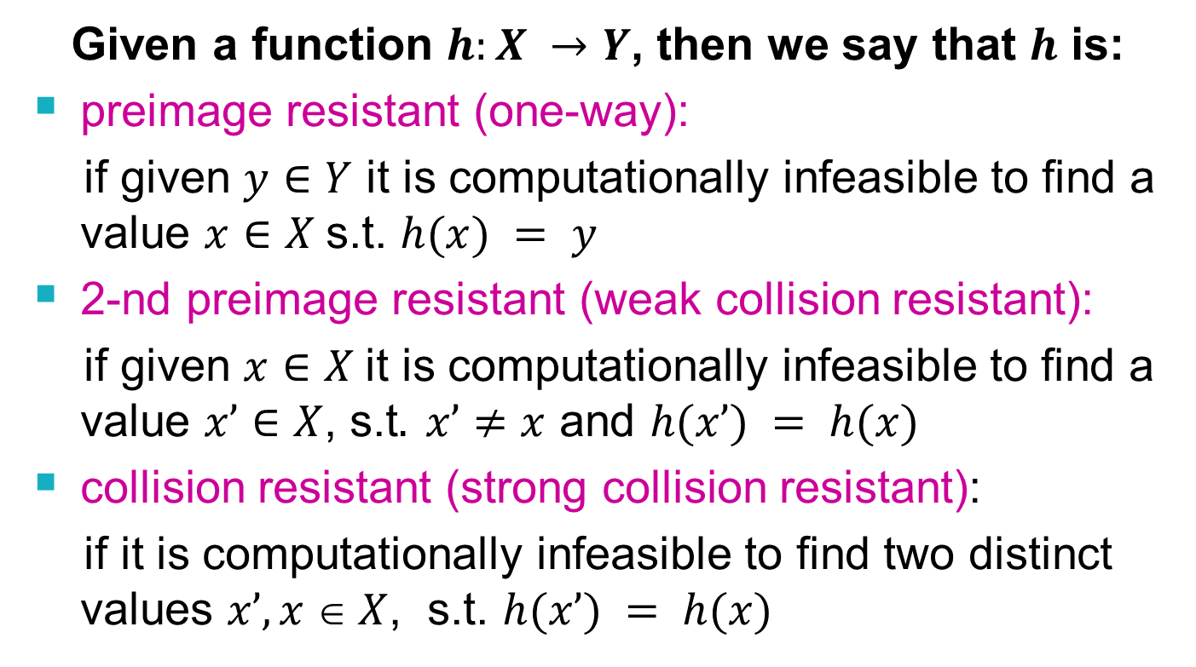
Security Requirements for Cryptographic Hash Functions
Given a function $h:X →Y$, then we say that $h$ is:
preimage resistant (one-way):
if given $y∈Y$ it is computationally infeasible to find a value $x∈X$s.t. $h(x) = y$
2-nd preimage resistant (weak collision resistant):
if given $x∈X$it is computationally infeasible to find a value $x’∈X$, s.t$. x’≠x$ and $h(x’) = h(x)$
collision resistant (strong collision resistant):
if it is computationally infeasible to find two distinct values $x’,x  X$, s.t. $h(x’) = h(x)$

Slide 30
Well Known Hash Functions
MD5 (outdated)
output 128 bits
collision resistance completely broken
SHA1 (outdated)
output 160 bits
collision attacks; length extension attacks
SHA2 (SHA-224, SHA-256, SHA-384, SHA-512)
outputs 224, 256, 384, and 512 bits, respectively
collision attacks; length extension attacks
SHA3
https://csrc.nist.gov/publications/detail/fips/202/final https://en.wikipedia.org/wiki/Secure_Hash_Algorithm

Slide 31
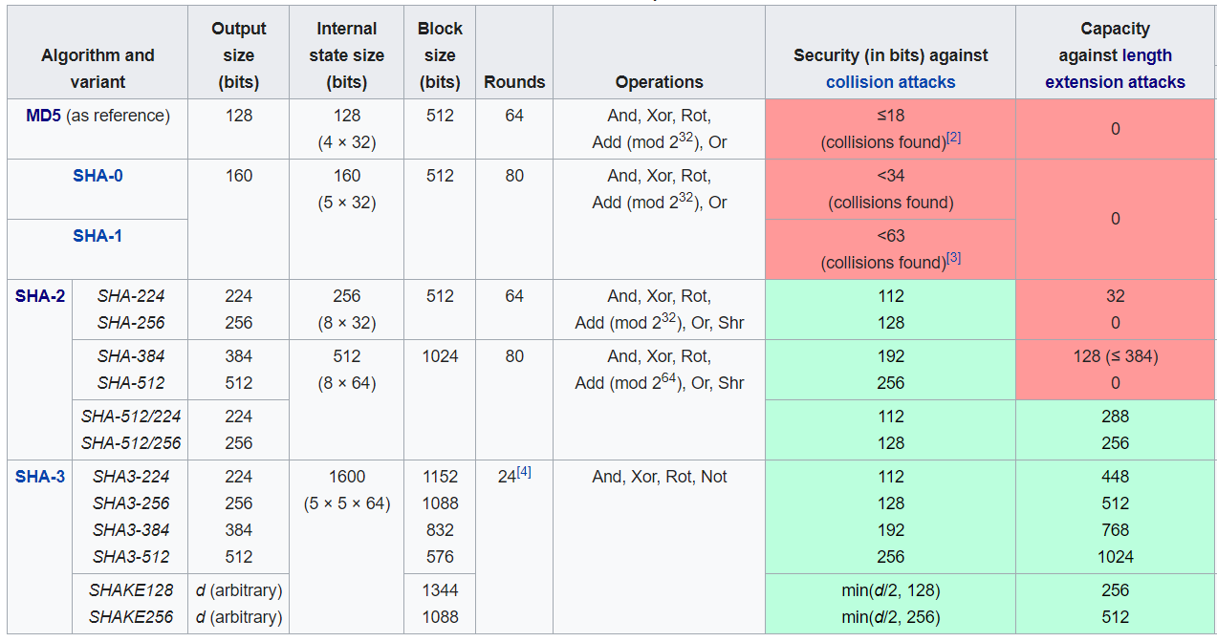
SHA-1, SHA-2, SHA-3
https://en.wikipedia.org/wiki/Secure_Hash_Algorithms

Slide 32
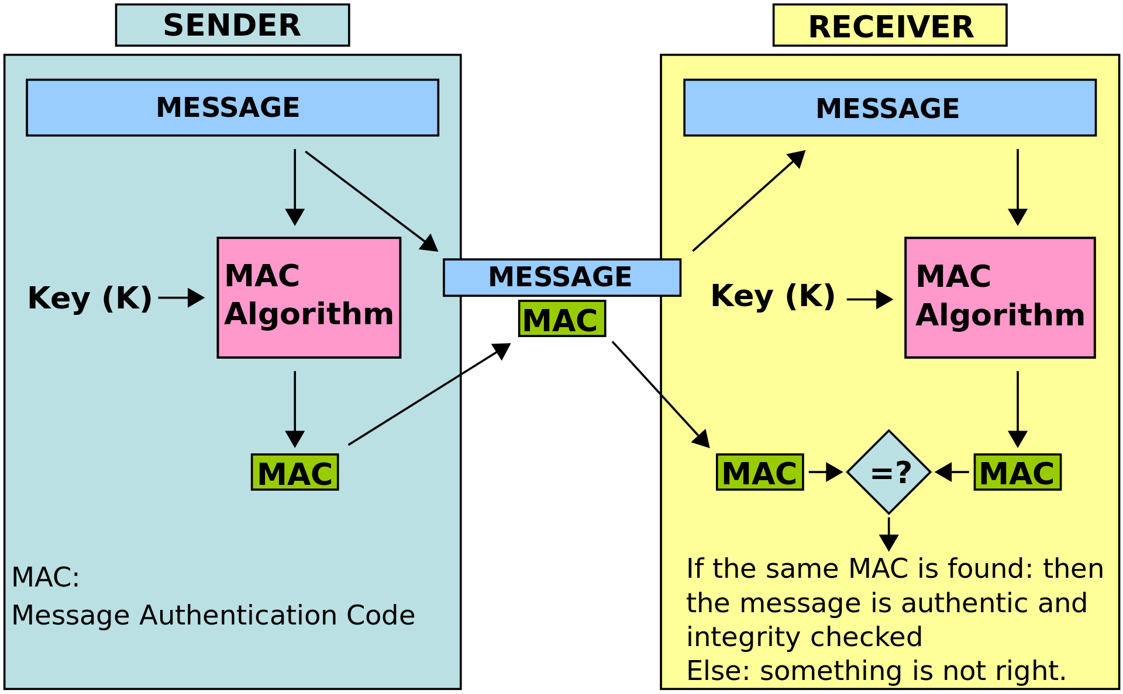
Message Authentication Code
tag
https://en.wikipedia.org/wiki/One-key_MAC

Slide 33
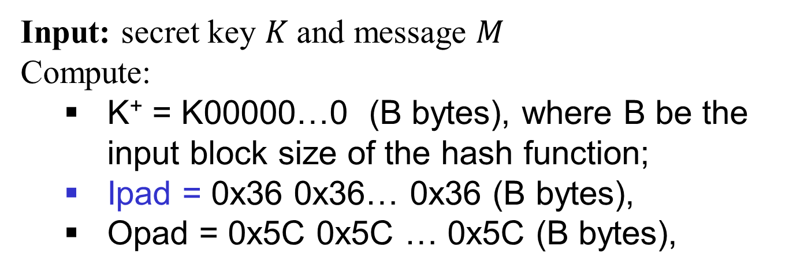
HMAC: Constructing MAC from Cryptographic Hash Functions
Hash-based message authentication code
Input: secret key $K$and message $M$
Compute:
K⁺ = K00000…0 (B bytes), where B be the input block size of the hash function;
Ipad = 0x36 0x36… 0x36 (B bytes),
Opad = 0x5C 0x5C … 0x5C (B bytes),
HMAC_{K}[M] = Hash[(K⁺ ⊕ opad) || Hash[(K⁺ ⊕ ipad)||M)]]
HMAC_{K}[M] = H(K’ || H(K’’ || M))

Slide 34
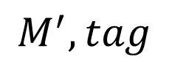

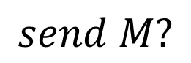

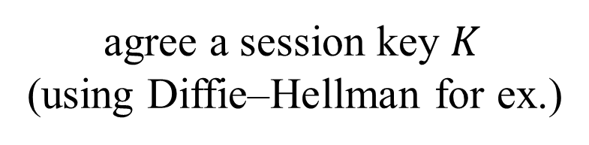
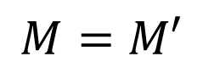
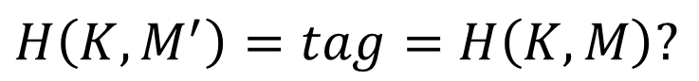
Authentication and integrity checking
How to ensure that the message is the original one?
How to verify that a message comes from the claimed sender?
Integrity?
Authentication?
MAC, HMAC
agree a session key $K$
(using Diffie–Hellman for ex.)
Alice
$$K$$
$$K$$
Bob
$$M, tag=HMAC\left(K,M\right)=H(K,M)$$
$$send M?$$
$$M^{′},tag$$
$H\left(K,M^{′}\right)=tag=$ $H\left(K,M\right)?$
$$M=M′$$

Slide 35
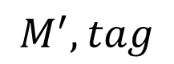
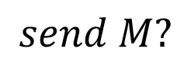
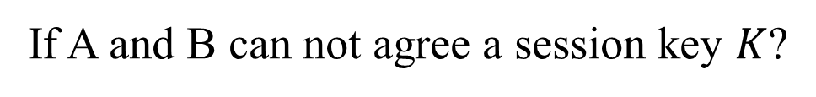
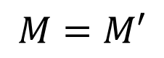
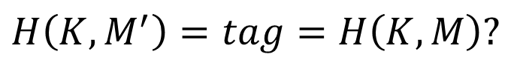
Authentication and integrity checking
How to ensure that the message is the original one?
How to verify that a message comes from the claimed sender?
Integrity?
Authentication?
MAC, HMAC
Offline?
If A and B can not agree a session key $K$?
Alice
Bob
$$M, tag=HMAC\left(K,M\right)=H(K,M)$$
$$send M?$$
$$M^{′},tag$$
$H\left(K,M^{′}\right)=tag=$ $H\left(K,M\right)?$
$$M=M′$$

Slide 36
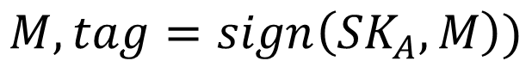
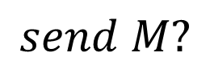
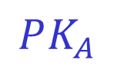
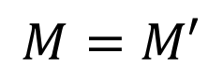
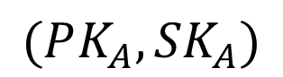
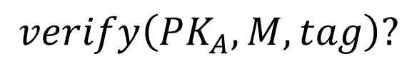
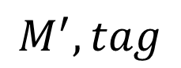
Digital signature
How to ensure that the message is the original one?
How to verify that a message comes from the claimed sender?
Integrity?
Authentication?
using digital signature
$$(PK_{A},{SK}_{A})$$
$$PK_{A}$$
Alice
Bob
$$send M?$$
$$M, tag=sign\left({SK}_{A},M\right))$$
$$M^{′},tag$$
$$verify\left(PK_{A},M,tag\right)?$$
$$M=M′$$

Slide 37
Digital Signature Properties
It must verify:
the author (signer)
the date and time of the signature
It must authenticate the contents at the time of the signature (integrity);
It must be verifiable by third parties (to resolve disputes);

Slide 38
Outline
Elgamal digital signature scheme
Schnorr digital signature scheme
NIST digital signature schemes
RSASSA-PKCS
RSASSA-PSS
ECDSA
Public key distribution (X.509 digital certificates)

Slide 39
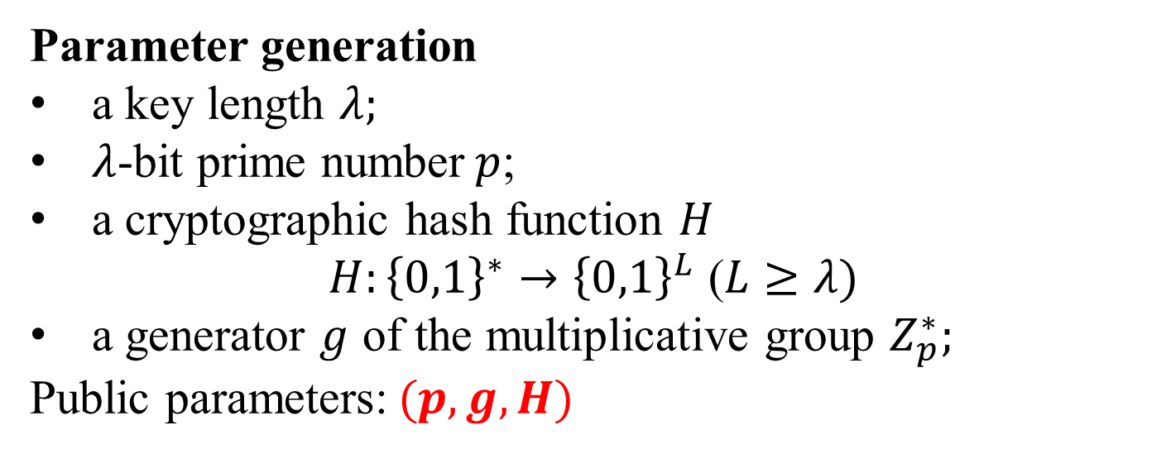
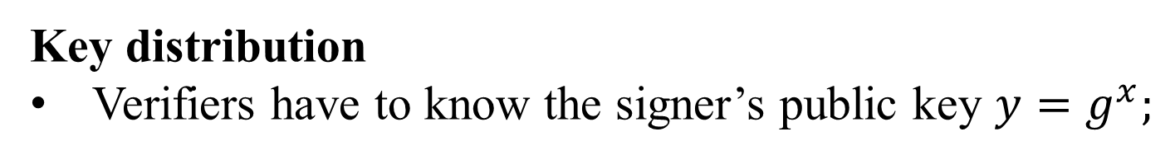

ElGamal Digital Signature
Parameter generation
a key length $λ;$
$λ$-bit prime number$p$;
a cryptographic hash function $H$
$H:{\left\{0,1\right\}}^{∗}→{\left\{0,1\right\}}^{L}$ ($L≥λ)$
a generator $g$ of the multiplicative group $Z_{p}^{∗};$
Public parameters:$(p, g, H)$
Key generation (for signer)
Secret key: ${x∈_{R}Z}_{p}^{∗};$
Public key: $y=g^{x} mod p;$
Key distribution
Verifiers have to know the signer’s public key $y=g^{x};$

Slide 40

ElGamal Digital Signature
Signing (the message $m$)
Choose ${k∈_{R}Z}_{p}^{∗}$
Compute $r=g^{k}$
Compute $s=\left(H\left(m\right)−x.r\right).k^{−1} mod (p−1)$
Output signature $(r, s)$
Verifying a signature
Input $(m^{′},r, s)$
Verify $0< r <p, 0 < s < p−1$
Verify $y^{r}.r^{s}mod p=g^{xr}.g^{k.\left(H\left(m\right)−x.r\right).k^{−1}}$
${=g}^{H(m)}=?g^{H(m^{′})}$
In public key
Secret key

Slide 41
Outline
Elgamal digital signature scheme
Schnorr digital signature scheme
NIST digital signature schemes
RSASSA-PKCS
RSASSA-PSS
ECDSA
Public key distribution (X.509 digital certificates)

Slide 42



Schnorr Digital Signature
Parameter generation
$prime numbers p$,q, where $p=qr+1$
a generator $g$ of the multiplicative group $Z_{p}^{∗};$
a cryptographic hash function $H$
$$H:{\left\{0,1\right\}}^{∗}→Z_{q}$$
Public parameters:$(p, q,g, H)$
Key generation (for signer)
Secret key: ${x∈_{R}Z}_{p}^{∗};$
Public key: $y=g^{x} mod p;$
Key distribution
Verifiers have to know the signer’s public key $y=g^{x};$

Slide 43

Schnorr Digital Signature
Signing (the message $m$)
Choose ${k∈_{R}Z}_{p}^{∗}$
Compute $r=g^{k}$
Compute $e=h(r|\left|m\right)∈Z_{q}$
Compute $s=k−x.e mod q$
Output signature $(s,e)$
Verifying a signature
Input $(m^{′},s, e)$
Compute $g^{s}.y^{e}mod p=g^{k−x.e }.g^{x.e}mod p$
${=g}^{k}=r_{v}$
Verify $e=h(r|\left|m\right)=?h(r_{v}||m^{′})$
Secret key
In public key

Slide 44
Outline
Elgamal digital signature scheme
Schnorr digital signature scheme
NIST digital signature schemes
RSASSA-PKCS
RSASSA-PSS
ECDSA
Public key distribution (X.509 digital certificates)

Slide 45
N I S T Digital Signature Algorithm
Published by N I S T as Federal Information Processing Standard F I P S 186 (1994)
https://nvlpubs.nist.gov/nistpubs/Legacy/FIPS/fipspub186.pdf
Makes use of the Secure Hash Algorithm (S H A)
The latest version, F I P S 186-4 (2013)
https://nvlpubs.nist.gov/nistpubs/FIPS/NIST.FIPS.186-4.pdf
Next version F I P S 186-5 (2019, 2022?)
https://csrc.nist.gov/publications/detail/fips/186/5/draft

Slide 46



Two Approaches to Digital Signatures
Finite field $Z_{p}$
G$roup ECC$
Notes:
The DSA uses an algorithm that is designed to provide only the digital signature
function. Unlike RSA, it cannot be used for encryption or key exchange.
Nevertheless, it is a public-key technique.
Figure 13.2 contrasts the DSA approach for generating digital signatures to
that used with RSA. In the RSA approach, the message to be signed is input to a
hash function that produces a secure hash code of fixed length. This hash code is
then encrypted using the sender’s private key to form the signature. Both the message
and the signature are then transmitted. The recipient takes the message and
produces a hash code. The recipient also decrypts the signature using the sender’s
public key. If the calculated hash code matches the decrypted signature, the signature
is accepted as valid. Because only the sender knows the private key, only the
sender could have produced a valid signature.
The DSA approach also makes use of a hash function. The hash code is provided
as input to a signature function along with a random number k generated
for this particular signature. The signature function also depends on the sender’s
private key (PR_{a} ) and a set of parameters known to a group of communicating principals.
We can consider this set to constitute a global public key (PU_{G} ). The result
is a signature consisting of two components, labeled s and r .
At the receiving end, the hash code of the incoming message is generated. This
plus the signature is input to a verification function. The verification function also
depends on the global public key as well as the sender’s public key (PU_{a} ), which
is paired with the sender’s private key. The output of the verification function is a
value that is equal to the signature component r if the signature is valid. The signature
function is such that only the sender, with knowledge of the private key, could
have produced the valid signature.

Slide 47

RSASSA Signatures
Public key is $(n,e)$, private key is $d$
To sign message $m:$ $s = hash(m)d mod n$
Signing and decryption are the same mathematical operation in RSA
To verify signature s on message m:
$se mod n = (hash(m)d)e mod n = hash(m)$
Verification and encryption are the same mathematical operation in RSA
Message must be padded and hashed (why?)

Slide 48

RSASSA Signatures
Padding $m$
PKCS #1(v2.1): RSASSA-PKCS
https://datatracker.ietf.org/doc/html/rfc3447
Probabilistic Signature Scheme: RSASSA-PSS

Slide 49


RSASSA-PSS Encoding
(0x)00 00 00 00 00 00 00 00
(0x) 00 ..00 01
(0x)bc
RSA encrypt
$$r$$
Notes:
The first stage in generating an RSA-PSS signature of a message
M is to generate from M a fixed-length message digest, called an encoded message
(EM ). Figure 13.6 illustrates this process.
We make several comments about the complex nature of this message digest
algorithm. All of the RSA-based standardized digital signature schemes involve appending
one or more constants (e.g., padding₁ and padding₂ ) in the process of forming
the message digest. The objective is to make it more difficult for an adversary to
find another message that maps to the same message digest as a given message or to
find two messages that map to the same message digest. RSA-PSS also incorporates
a pseudorandom number, namely the salt. Because the salt changes with every use,
signing the same message twice using the same private key will yield two different
signatures. This is an added measure of security.

Slide 50




R S ASSA-P S S verifying
$$r$$
$$(M^{∗},r)$$
$$M^{∗}$$
RSA decrypt
Notes:
Figure 13.7 RSA-PSS EM Verification
The shaded boxes labeled H and H′ correspond, respectively, to the value contained in the decrypted signature and the value generated from the message M associated with the signature. The remaining three shaded areas contain values generated from the decrypted signature and compared to known constants. We can now see more clearly the different roles played by the constants and the pseudorandom value salt, all of which are embedded in the EM generated by the signer. The constants are known to the verifier, so that the computed constants can be compared to the known constants as an additional check that the signature is valid (in addition to comparing H and H′). The salt results in a different signature every time a given message is signed with the same private key. The verifier does not know the value of the salt and does not attempt a comparison. Thus, the salt plays a similar role to the pseudorandom variable k in the NIST DSA and in ECDSA. In both of those schemes, k is a pseudorandom number generated by the signer, resulting in different signatures from multiple signings of the same mes- sage with the same private key. A verifier does not and need not know the value of k.

Slide 51

The Digital Signature Algorithm (D S A)
DSA Parameters
Notes:
The DSA is based on the difficulty of computing discrete logarithms (see Chapter 2)
and is based on schemes originally presented by Elgamal [ELGA85] and Schnorr
[SCHN91].
Figure 13.3 summarizes the algorithm.
There are three parameters that are public and can be common to a group of users. An N-bit prime number q is chosen. Next, a prime number p is selected with a length between 512 and 1024 bits such that q divides (p - 1). Finally, g is chosen to be of the form h^{(p-1)/q} mod p, where h is an integer between 1 and (p - 1) with the restriction that g must be greater than 1. Thus, the global public-key components of DSA are the same as in the Schnorr sig- nature scheme.
With these parameters in hand, each user selects a private key and generates a public key. The private key x must be a number from 1 to (q - 1) and should be chosen randomly or pseudorandomly. The public key is calculated from the private key as y = g^{x} mod p. The calculation of y given x is relatively straight- forward. However, given the public key y, it is believed to be computationally infeasible to determine x, which is the discrete logarithm of y to the base g, mod p (see Chapter 2).
The signature of a message M consists of the pair of numbers r and s, which are functions of the public key components (p, q, g), the user’s private key (x), the hash code of the message H(M), and an additional integer k that should be generated randomly or pseudorandomly and be unique for each signing.
Let M, r′, and s′ be the received versions of M, r, and s, respectively. Verification is performed using the formulas shown in Figure 13.3. The receiver generates a quantity v that is a function of the public key components, the sender’s public key, the hash code of the incoming message, and the received versions of r and s. If this quantity matches the r component of the signature, then the signature is validated.

Slide 52






The Digital Signature Algorithm (D S A)
DSA Parameters
$2^{L−1}<p<2^{L}, p−1⋮q$
$2^{N−1}<q<2^{N}$
$$\left\langle g\right\rangle =GF\left(p\right)=ℤ_{p}$$
$$H:{\left\{0,1\right\}}^{∗}→{\left\{0,1\right\}}^{l};l≤min⁡(L,N)$$
Key generation (for signer)
Secret key: $x∈_{R}[1,q−1]$
Public key: y$=g^{x}mod p∈ℤ_{p}$
Notes:
The DSA is based on the difficulty of computing discrete logarithms (see Chapter 2)
and is based on schemes originally presented by Elgamal [ELGA85] and Schnorr
[SCHN91].
Figure 13.3 summarizes the algorithm.
There are three parameters that are public and can be common to a group of users. An N-bit prime number q is chosen. Next, a prime number p is selected with a length between 512 and 1024 bits such that q divides (p - 1). Finally, g is chosen to be of the form h^{(p-1)/q} mod p, where h is an integer between 1 and (p - 1) with the restriction that g must be greater than 1. Thus, the global public-key components of DSA are the same as in the Schnorr sig- nature scheme.
With these parameters in hand, each user selects a private key and generates a public key. The private key x must be a number from 1 to (q - 1) and should be chosen randomly or pseudorandomly. The public key is calculated from the private key as y = g^{x} mod p. The calculation of y given x is relatively straight- forward. However, given the public key y, it is believed to be computationally infeasible to determine x, which is the discrete logarithm of y to the base g, mod p (see Chapter 2).
The signature of a message M consists of the pair of numbers r and s, which are functions of the public key components (p, q, g), the user’s private key (x), the hash code of the message H(M), and an additional integer k that should be generated randomly or pseudorandomly and be unique for each signing.
Let M, r′, and s′ be the received versions of M, r, and s, respectively. Verification is performed using the formulas shown in Figure 13.3. The receiver generates a quantity v that is a function of the public key components, the sender’s public key, the hash code of the incoming message, and the received versions of r and s. If this quantity matches the r component of the signature, then the signature is validated.

Slide 53

The Digital Signature Algorithm (D S A)
Signing (the message $m$)
Choose secret for each message: $k∈_{R}[1,q−1]$
Compute $r={(g}^{k}mod p) mod q$
Compute $s=k^{−1}(H\left(m\right)+x.r) mod q$
Output signature $(r,s)$

Slide 54

The Digital Signature Algorithm (D S A)
Signing (the message $m$)
$(m, r,s)$ $r={(g}^{k}mod p) mod q$
$s=k^{−1}(H\left(m\right)+x.r) mod q$
Verifying a signature
Input $(m^{′},r,s)$
Compute:
$w{=s}^{−1}mod q={\left(H\left(m\right)+x.r\right)}^{−1}.k mod q$
$u_{1}=H\left(m^{′}\right).w$ mod q
=${H\left(m^{′}\right)\left(H\left(m\right)+x.r\right)}^{−1}.k$
$u_{2}=r.w=r.{\left(H\left(m\right)+x.r\right)}^{−1}.k$ mod q
Verify $v=g^{u_{1}}.y^{u_{2}}$= $g^{u_{1}}$. $g^{{x.u}_{2}}=g^{u_{1}+x.u_{2}}$
$=g^{k(H(m^{′})+x.r)({\left(H\left(m\right)+x.r\right)}^{−1})}=?r$
In public key
Secret key

Slide 55
Outline
Elgamal digital signature scheme
Schnorr digital signature scheme
NIST digital signature schemes
RSASSA-PKCS
RSASSA-PSS
ECDSA

Slide 56




Elliptic Curve Digital Signature Algorithm (E C D S A)
ECDSA parameters
Prime number: $p$
Curve coefficients: $a,b∈ℤ_{p}$
Base points: $G∈E(ℤ_{q})$
T$he number n=ord(\left\langle G\right\rangle )$
The number $h=\frac{ord (E\left(ℤ_{p}\right) ) }{n}$
$H:{\left\{0,1\right\}}^{∗}→{\left\{0,1\right\}}^{l}$, $l=l(n)$
NIST.FIPS.186-5
Key generation (for signer)
Secret key: d$∈_{R}[1,n−1]$
Public key: Q$=d.G∈E(ℤ_{p})$
Notes:
The DSA is based on the difficulty of computing discrete logarithms (see Chapter 2)
and is based on schemes originally presented by Elgamal [ELGA85] and Schnorr
[SCHN91].
Figure 13.3 summarizes the algorithm.
There are three parameters that are public and can be common to a group of users. An N-bit prime number q is chosen. Next, a prime number p is selected with a length between 512 and 1024 bits such that q divides (p - 1). Finally, g is chosen to be of the form h^{(p-1)/q} mod p, where h is an integer between 1 and (p - 1) with the restriction that g must be greater than 1. Thus, the global public-key components of DSA are the same as in the Schnorr sig- nature scheme.
With these parameters in hand, each user selects a private key and generates a public key. The private key x must be a number from 1 to (q - 1) and should be chosen randomly or pseudorandomly. The public key is calculated from the private key as y = g^{x} mod p. The calculation of y given x is relatively straight- forward. However, given the public key y, it is believed to be computationally infeasible to determine x, which is the discrete logarithm of y to the base g, mod p (see Chapter 2).
The signature of a message M consists of the pair of numbers r and s, which are functions of the public key components (p, q, g), the user’s private key (x), the hash code of the message H(M), and an additional integer k that should be generated randomly or pseudorandomly and be unique for each signing.
Let M, r′, and s′ be the received versions of M, r, and s, respectively. Verification is performed using the formulas shown in Figure 13.3. The receiver generates a quantity v that is a function of the public key components, the sender’s public key, the hash code of the incoming message, and the received versions of r and s. If this quantity matches the r component of the signature, then the signature is validated.

Slide 57

Elliptic Curve Digital Signature Algorithm (E C D S A)
Signing (the message $m$)
Choose secret for each message: $k∈_{R}[1,n−1]$
Compute $R=k.G=\left(x_{1},y_{1}\right), r=x_{1}$
Compute $s=k^{−1}(H\left(m\right)+d.r) mod n$
Output signature $(r,s)$

Slide 58

Elliptic Curve Digital Signature Algorithm (E C D S A)
Signing (the message $m$)
$(m, r,s)$ $r=x_{1} where kG=(x_{1},y_{1})$
$s=k^{−1}\left(H\left(m\right)+d.r\right)mod n$
Verifying a signature
Input $(m^{′},r,s)$
Compute:
$w{=s}^{−1}mod q={\left(H\left(m\right)+d.r\right)}^{−1}.k mod n$
$u_{1}=H\left(m^{′}\right).w$ mod n =${H\left(m^{′}\right)\left(H\left(m\right)+d.r\right)}^{−1}.k$ mod n
$u_{2}=r.w=r.{\left(H\left(m\right)+d.r\right)}^{−1}.k$ mod n
$v_{x}=u_{1}G+u_{2}Q=\left(u_{1}+du_{2}\right)G$
$=k(H\left(m^{′})+d.r\right)\left({\left(H\left(m\right)+d.r\right)}^{−1}\right)G=\left(x_{1}^{′},y_{1}^{′}\right)$
Verify $v_{x}=x_{1}^{′}=?r$
In public key
Secret key

Slide 59
Digital Signature Requirements
The signature must be a bit pattern that depends on the message being signed;
The signature must use some information unique to the sender to prevent both forgery and denial;
It must be relatively easy to produce the digital signature;
It must be relatively easy to recognize and verify the digital signature;
It must be computationally infeasible to forge a digital signature, either by constructing a new message for an existing digital signature or by constructing a fraudulent digital signature for a given message;
It must be practical to retain a copy of the digital signature in storage;

Slide 60
Outline
Elgamal digital signature scheme
Schnorr digital signature scheme
NIST digital signature schemes
RSASSA-PKCS
RSASSA-PSS
ECDSA
Public key distribution (X.509 digital certificates)

Slide 61

Public key distribution
$$(M=\{user, public key,…\},s)$$
CERTIFICATE
Issuer
Subject
Subject Public Key
Issuer Digital
Signature

Slide 62
X.509 digital certificate Formats
Version: which version the certificate is using
Serial number: a unique # assigned to the certificate within the same CA
Algorithm: name of the hash function and the public-key encryption algorithm
Issuer: name of the issuer
Validity period: time interval when the certificate is valid
Subject: name of the certificate owner
Public key: subject’s public-key and parameter info.
Extension: other information (only available in version 3)
Properties: encrypted hash value of the certificate using K_{CA}^{r}

Slide 63
Public Key Infrastructure (PKI)
PKI is a mechanism for using PKC
PKI issues and manages subscribers’ public-key certificates and CA networks:
Determine users’ legitimacy
Issue public-key certificates upon users’ requests
Extend public-key certificates’ valid time upon users’ requests
Revoke public-key certificates upon users’ requests or when the corresponding private keys are compromised
Store and manage public-key certificates
Prevent digital signature singers from denying their signatures
Support CA networks to allow different CAs to authenticate public-key certificates issued by other CAs

Slide 64
X.509 PKI (PKIX)
Recommended by IETF
Four basic components:
end entity
certificate authority (CA): responsible of issuing and revoking public-key certificates;
registration authority (RA): verifying identities of owners of public-key certificates
Repository: responsible of storing and managing public-key certificates
https://datatracker.ietf.org/doc/html/rfc5280
(2008, updated 2013, 2018)
Notes:
64

Slide 65

PKIX Architecture
Transaction managements:
Registration
Initialization
Certificate issuing and publication
Key recovery
Key generation
Certificate revocation
Cross-certification

Slide 66
X.509 digital certificate
Problems
How are Digital Certificates Issued?
Who is issuing them?
Why should I Trust the Certificate Issuer?
How can I check if a Certificate is valid?
How can I revoke a Certificate?
Who is revoking Certificates?

Slide 67
X.509 digital certificate
Example: check digital certificate of “facebook.com”
Check server certificate
echo | openssl s_client -servername www.facebook.com -connect www.facebook.com:443 2>1 | openssl x509 -text
Dowload server cert
echo | openssl s_client -servername www.facebook.com -connect www.facebook.com:443 2>1 | openssl x509 -out facebook.cer -text
Check server cert file
openssl x509 -in facebook.cer -inform pem -text -noout
https://www.openssl.org/docs/man1.1.1/man1/openssl-s_client.html
https://www.openssl.org/docs/man1.1.1/man1/openssl-x509.html

Slide 68
CA Technology Evolution
CA
CA
CA
CA
Directory
Services
CA
RA
CA
CA
CA
RA
RA
Internet
RA
RA
RA
Internet
LRA
LRA
openssl s_client -connect facebook.com:443 -showcerts

Slide 69

Cross-certification between two PKIs

